Slide 1
Postoperative intestinal obstruction
persistent paralytic ileus vs. early mechanical obstruction
Early evidence of obstruction (days 1–5) is usually due to non-strangulating causes such as ﬁbrinous adhesions and oedema.
Obstruction is usually incomplete and the majority settle with conservative management.
Late postoperative obstruction (>7 days) is usually more signiﬁcant , and timely surgical intervention is usually required

Slide 2
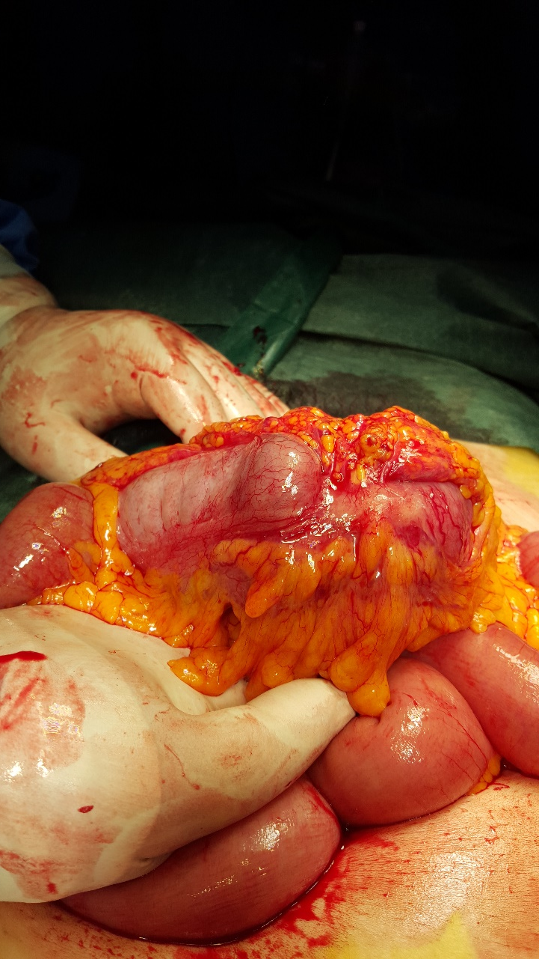
Adult intussusception
represents 5% of all cases of intussusception and accounts for only 1%-5% of intestinal obstructions in adults.
In children, it is usually primary and benign, and pneumatic or hydrostatic reduction
of the intussusception is sufficient to treat the condition in 80% of the patients.
In 90% of the cases of intussusception in adults are secondary to a pathologic
condition that serves as a lead point, such as carcinomas, polyps,
Meckel’s diverticulum, colonic diverticulum, strictures or benign neoplasms,
which are usually discovered intraoperatively.
Due to a significant risk of associated malignancy, which approximates 65%,
radiologic decompression is not addressed preoperatively in adults.
70 to 90% of adult cases of intussusception require definite treatment, of which
surgical resection is the treatment of choice.

Slide 3
LARGE BOWEL OBSTRUCTION
Acute or chronic
Carcinoma
Volvulus
Diverticular disease
Pseudo-obstruction
CHRONIC LARGE BOWEL OBSTRUCTION
• intramural – faecal impaction
• mural – colorectal cancer, diverticulitis, strictures (Crohn’s disease, ischaemia), anastomotic stenosis
• extramural – metastatic deposits, endometriosis; or
functional:
• Hirschsprung’s disease, idiopathic megacolon, pseudoobstruction.

Slide 4
Volvulus
Twisting or axial rotation of a portion of bowel about its mesentery. When complete it forms a closed loop of obstruction with resultant ischaemia secondary to vascular occlusion.
primary or secondary.
The primary form occurs secondary to congenital malrotation of the gut, abnormal mesenteric attachments or congenital bands. Examples include volvulus neonatorum, caecal volvulus and sigmoid volvulus.
A secondary volvulus, which is the more common variety, is due to rotation of a piece of bowel around an acquired adhesion or stoma.

Slide 5
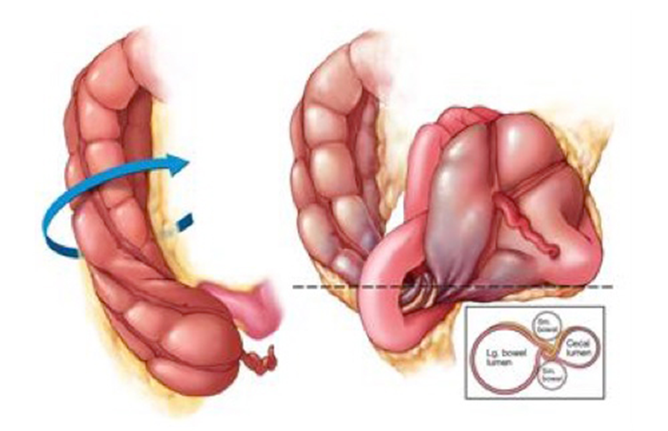
Volvulus of the small intestine
This may be primary or secondary and usually occurs in the lower ileum.
It may occur spontaneously in African people, particularly following the consumption of a large volume of vegetable matter.
whereas in the west it is usually secondary to adhesions passing to the parietes or female pelvic organs.
Caecal volvulus
This may occur as part of volvulus neonatorum or de novo and
is usually a clockwise twist.
It is more common in females
and usually presents acutely with the classic features of obstruction.
At ﬁrst the obstruction may be partial
In 25% of cases, examination may reveal a palpable tympanic
swelling in the midline or left side of the abdomen.

Slide 6
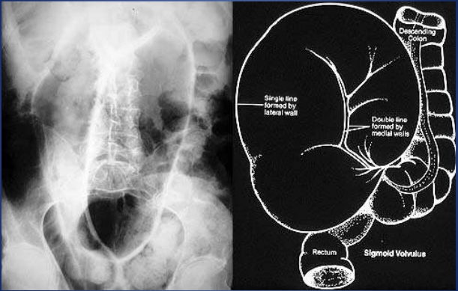
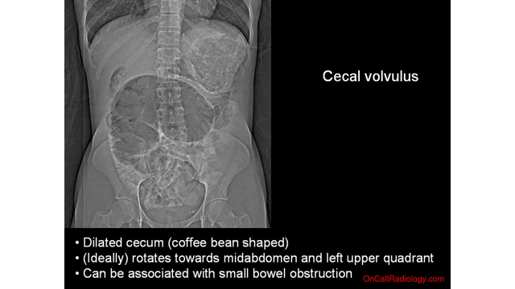
Plain radiograph
Marked distension of a loop of large bowel with its long axis extending from the right lower quadrant to the epigastrium or left upper quadrant.
The general caliber for the cecum is < 9cm .
The colonic haustral pattern is generally maintained in contradistinction to a sigmoid volvulus.
One air-fluid level may be seen in the cecal volvulus in comparison to the sigmoid volvulus with a few air-fluid levels.
The 3-6-9 rule is a simple aide memoire describing the normal bowel caliber:
small bowel: <3 cm
large bowel: <6 cm
cecum: <9 cm
Above these dimensions, obstruction should be considered

Slide 7
Treatment of caecal volvulus
At operation the volvulus should be reduced. Sometimes, this can only be achieved after decompression of the caecum using a needle.
ﬁxation of the caecum to the right iliac fossa (caecopexy) and/or a caecostomy.
If the caecum is ischaemic or gangrenous, a right hemicolectomy should be performed.
Sigmoid volvulus
rare in Europe and the USA but more common in Eastern Europe and Africa.
Rotation nearly always occurs in the anticlockwise direction.
The symptoms are of large bowel obstruction, which may initially be intermittent followed by the passage of large quantities of ﬂatus and faeces.
younger patients develop more acute form.
Abdominal distension is an early and progressive sign, which may be associated with hiccough and retching; vomiting occurs late.
Constipation is absolute.
In the elderly, a more chronic form may be seen.

Slide 8
Sigmoid volvulus may occur in :
sigmoid elongation, resulting in a redundant loop.
Institutionalized patients with neuropsychiatric disorders often develop sigmoid volvulus.
in patients with Parkinson disease, multiple sclerosis, or spinal cord injury.
excessive use of laxatives, cathartics, and enemas is highly associated with the development of sigmoid volvulus.
In developing countries, a high-fiber diet leads to overloading of the sigmoid colon, which twists around its mesentery and results in volvulus.
Megacolon, either congenital or acquired through Chagas disease, predisposes to the development of sigmoid volvulus.
The presence of a pelvic mass also increases the risk of developing sigmoid volvulus. The mass displaces the sigmoid colon sufficiently to result in torsion of the mesentery and subsequent volvulus.
The association of pregnancy and large ovarian tumors with sigmoid volvulus is well known

Slide 9
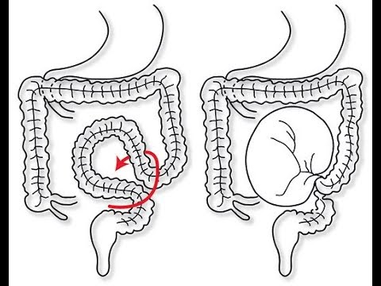
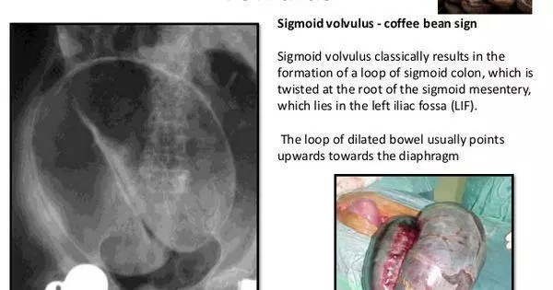
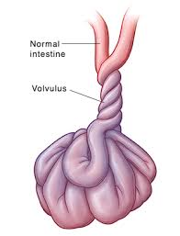

Slide 10
Treatment of sigmoid volvulus
Flexible sigmoidoscopy or rigid sigmoidoscopy and insertion of a ﬂatus tube should be carried out to allow deﬂation of the gut. Success, as long as ischaemic bowel is excluded, will provide temporary respite, allowing resuscitation and an elective procedure.
Failure results in an early laparotomy, with untwisting of the loop and per anum decompression . When the bowel is viable, ﬁxation of the sigmoid colon to the posterior abdominal wall may be a safer manoeuvre in inexperienced hands. Resection is preferable if it can be achieved safely.
A Paul–Mikulicz procedure is useful, particularly if there is suspicion of impending gangrene ; an alternative procedure is a sigmoid colectomy and, when anastomosis is considered unwise, a Hartmann’s procedure with subsequent reanastomosis can be carried out

Slide 11
Pseudo-obstruction
Obstruction, usually of the colon, that occurs in the absence of a mechanical cause or acute intraabdominal disease.
It is associated with a variety of syndromes in which there is an underlying neuropathy and/or myopathy and a range of other factors

Slide 12
Small intestinal pseudo-obstruction
primary (i.e. idiopathic or associated with familial visceral myopathy)
secondary.
The clinical picture consists of recurrent subacute obstruction.
The diagnosis is made by the exclusion of a mechanical cause.
Treatment consists of initial correction of any underlying disorder.
Metoclopramide and erythromycin may be of use.

Slide 13
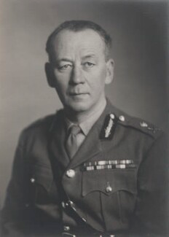
Colonic pseudo-obstruction
acute
chronic
The acute form, also known as Ogilvie’s syndrome, presents as acute large bowel obstruction. Abdominal radiographs show evidence of colonic obstruction, with marked caecal distension being a common feature. Indeed, caecal perforation is a well-recognised complication

Slide 14
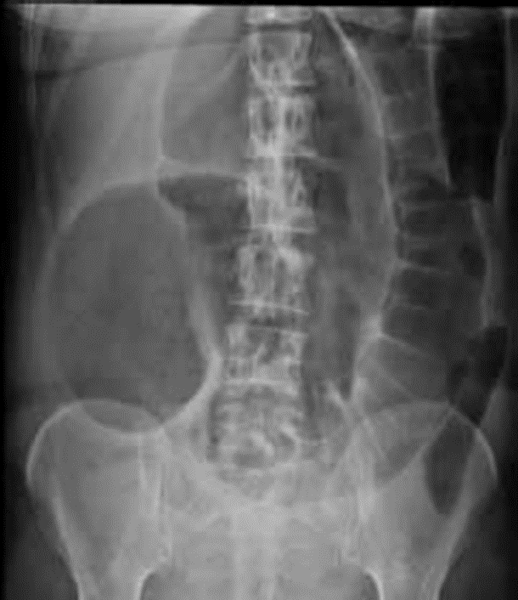

Slide 15
The absence of a mechanical cause requires urgent conﬁrmation by colonoscopy or a single-contrast water-soluble barium enema or CT.
pseudo-obstruction should be treated by colonoscopic decompression. It may recur in 25% of cases, necessitating further colonoscopy with simultaneous placement of a ﬂatus tube.
When colonoscopy fails or is unavailable, a tube caecostomy may be required.
Continued symptoms may beneﬁt from surgical intervention with subtotal colectomy and ileorectal anastomosis.

Slide 17
Acute mesenteric ischaemia
is the sudden decrease in blood supply to the bowel, resulting in bowel ischaemia and, if not promptly treated, rapid gangrene.
The common causes of acute mesenteric ischaemia can be classified into:
Thrombus-in-situ (Acute Mesenteric Arterial Thrombosis, AMAT)
Embolism (Acute Mesenteric Arterial Embolism, AMAE)
Non-occlusive cause (Non-Occlusive Mesenteric Ischemia, NOMI)
Venous occlusion and congestion (Mesenteric Venous Thrombosis, MVT)
Type Proportion of Cases Underlying Cause
AMAT 25% Atherosclerosis
AMAE 50% Cardiac causes* or abdominal / thoracic aneurysm
NOMI 20% Hypovolemic Shock, Cardiogenic Shock
MVT <10% Coagulopathy, Malignancy, or Inflammatory Disorders
*Cardiac causes include arrhythmias (e.g. AF), post-MI mural thrombus, or prosthetic heart valve

Slide 19
Risk Factors
The risk factors for acute mesenteric ischaemia depend on the underlying cause.
Specifically however for AMAE, the main reversible risk factors are smoking, hyperlipidaemia, and hypertension, much the same as for chronic mesenteric ischaemia.
Clinical Features
generalised abdominal pain, out of proportion to the clinical findings, although it can often be more variable or subtle than this. The patient will typically complain of a diffuse and constant pain, with associated nausea and vomiting present in around 75% of cases.
On examination, the abdomen is often unremarkable* and the patient may find it difficult to localise the pain.
Importantly, take note of any potential embolic sources, such as AF, heart murmurs, or signs of previous valvular replacement surgery.
*A history of AF or other cardiovascular disease increase the likelihood towards this diagnosis, and other points in the history to consider are previous DVT or PE or hypercoaguable states (e.g. active neoplasia or anti-phospholipid syndrome

Slide 20
Investigations
Laboratory Tests
An arterial blood gas (ABG) should be performed urgently, to assess the degree of acidosis and serum lactate, secondary to the severity of bowel infarction.
Routine blood tests that should be performed, including CBC, U&Es, clotting (especially if patient anti-coagulated), amylase*, and LFTs (if the coeliac trunk is affected, ischemia of the liver may cause derangement), as well as a group and save
*Whilst an amylase is commonly measured to exclude pancreatitis as a cause of the abdominal pain, counter-intuitively amylase also rises in mesenteric ischaemia, as well as ectopic pregnancy, bowel perforation, and diabetic ketoacidosis.

Slide 21
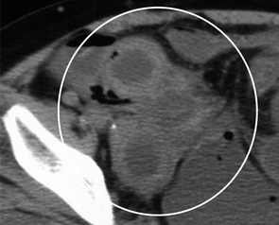
Imaging
The definitive diagnosis of acute mesenteric ischaemia, for both arterial and venous mesenteric disease, requires a CT scan with IV contrast
Arterial bowel ischaemia will initially show on CT imaging
as oedematous bowel, secondary to the ischaemia
and vasodilatation, before progressing to a loss of bowel wall
enhancement* and then to pneumatosis.
*Oral contrast should be avoided in cases of
mesenteric ischaemia due to difficulty in assessing
for bowel wall enhancement
Any suspicion of a bowel perforation warrants
an initial AXR and erect CXR;
if there is significant suspicion,
then a CT abdomen with contrast is indicated
CT image of lower abdomen in patient
with strangulating obstruction.
Bowel wall of involved segment is thickened
and shows increased density (circle)
indicating hemorrhagic infarction.
Involved mesentery shows high attenuation.

Slide 22
Circulatory disturbances
Correction of shock and repletion of body fluid should proceeds any
operative management.
In haemoconcentration due to loss of plasma or saline from circulation ,
the proportionate reduction in plasma volume can be assessed from the
change of haematocrit value or concentration by assuming that the
red cell mass stays constant

Slide 23
Fall in plasma volume( expressed as percentage of original) =
100 1 _ H1 100 – H2
100 – H1 H2
H1 = 45
H2 = 52
24%
For each 1% rise in Ht, the fall in P. Vol. is approx. 4%

Slide 24
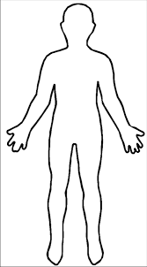
3 L
The fall in plasm =720 ml
ECF 15 L
720 * 5 = 3600 ml

